Slide 1
21st Century Employability Skills
Rajinder Gill
21st Century Skills Director
New World of Work, Feather River College

Slide 2
Partnerships
New World of Work:
Funded by the California Community College Chancellor's Office through the Doing What Matters Initiative. Collaborates with employers, workforce development boards, educators, and research organizations across the country to build 21st Century Employability Skills
Partners Include:
CA Community Colleges Chancellor’s Office
Foundation for CA Community Colleges
National Association for Community College Entrepreneurship
Mozilla Foundation
MDRC National Research Group
CalHR
Jobs for the Future

Slide 3
Connecting Educators, Employers, & Students: Ranker Interview
https://www.youtube.com/watch?v=OYMSJa9i5cc

Slide 4
New World of Work Timeline
2012-13 Research & Skills Panels
2013-14 Created Curriculum & Pilot at Feather River
2015 Pilot at 10 CCC, NACCE, Foundation CCC, and CalHR Partnerships
2016 Digital Badging & Evaluation, Expanded Pilot to 13 CCC, Mozilla, MDRC & JFF Partnerships

Slide 5
Timeline of the New World of Work
2012
2013
Started in 2012 at Feather River College through CTE/EWD program
Career development research and futurist projections on emerging “knowledge” or “human” economy: work skills that can’t be automated, growing focus on freelance/contract work
Skills panels were conducted to align research with input from employers, recruiters, educators and students
Created the “Top 10” list of essential 21st Century Employability Skills

Slide 6
“Top 10” 21st Century Skills
Adaptability
Analysis/Solution Mindset
Collaboration
Communication
Digital Fluency
Entrepreneurial Mindset
Empathy
Resilience
Self-Awareness
Social/Diversity Awareness

Slide 7
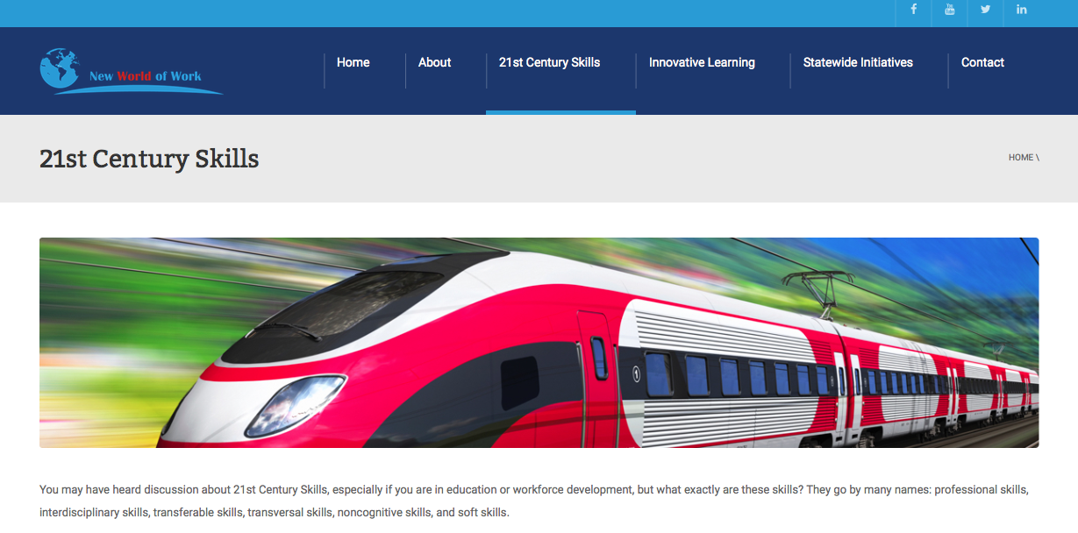
21st Century Skills: Fast Track to the Future
Go by many names:
Competencies, cross-disciplinary skills, college/career readiness skills, transferable skills, employability skills, and soft skills.
What they are:
Knowledge, work habits, and character traits necessary to succeed in this rapidly changing world.
The good news:
Just like any other subject, 21st Century Skills can be taught, practiced, and incorporated into everyone’s life.

Slide 8
Timeline of the New World of Work
2014
2015
Funding from Adult Education, CTE, and EWD grants, used to create 2 modules per skill, for a total of 20 lessons
Each module contains a lesson plan for instructors, presentation, a “what not to do” video teaser or longer video assessment, and handouts
Lessons first tested with over 200 students at Feather River College in conjunction with workplace learning
The NWoW website was created to host all modules with free download access
www.newworldofwork.org
IDRC grant allowed expansion to a pilot of 10 partner community colleges, just added 3 additional colleges

Slide 9
Current Curriculum Pilot in California

Slide 10
Timeline of the New World of Work
2015
2016
With the CSI project, New World of Work was one of the models under review while the state determined if there would be a shift to competency based talent management
NWoW was chosen as the model of reference as CalHR designs new foundational guidelines for competencies
NWoW partnering with FCCC to create ten 21st Century Skills badges for postsecondary students
Badges will be hosted through the Foundation’s LaunchPath site www.launchpath.com
Fall 2016, will begin to integrate 21st Century Skills workshops in prison education settings

Slide 11
What are Digital Badges?
Online visual representation of learning
Used in education and workforce as marker of achievement, skill, knowledge, and work-readiness
Mozilla Open Badge Eco-System allows public recognition of badges
Learners can display badges across multiple sites such as FB, Twitter, LinkedIn
Visual way for employer to understand skillset of potential applicants at a glance
The 21st Century Skills badges will have the option for embedded employer verification, which provides the bridge from skills to competencies

Slide 12
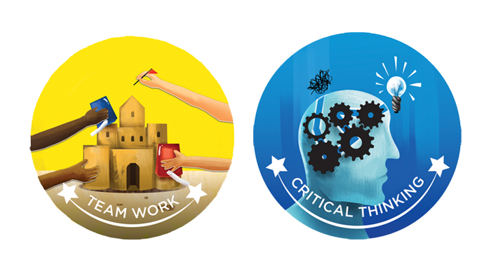
Anatomy of a digital badge

Slide 13
Questions?

Slide 14
Social-Diversity Awareness Lesson 2:
Disabilities, Diversity,
Multi-Generations

Slide 15
Multi-Generational Workforces
Reference Book:
Unlocking Generational CODES, Anna Liotta
--Learning how to incorporate communication, collaboration, and other core skills to navigate differences in the workforce.

Slide 16
Due to longer average life spans, developmental definitions are changing:
0-20 is considered Child Life Stage
21-41 is considered Young Adult Life Stage
42-62 is Mid-Life
63-83 is Elderhood
84+ is Bonus Elderhood

Slide 17
generational Definitions
What factors are taken into account when establishing different generations? What defines a generation?
Can you name the current generations in the US Workforce?

Slide 18
Four Generations exist in the US Workforce:
Veterans/ Traditionalists: 1927-1945, 7.6% of workforce
(Those who are working are often in part-time/consulting positions)
Baby Boomers: 1946-1963, 27.2% of workforce
(A split between those who’ve put off retirement and those who will be retiring soon)
Generation Xers: 1964-1979, 33.2% of workforce
(Age range from 37-52 yrs old, so represent both leaders and prime age workers)
Generation Y/ Millennials: 1980-1999, 32% of workforce
(Age range from 17-36 yrs. old, the rising majority in the workforce along with Gen X)
The generation from 2000- Present is still under definition/ research for workforce impact. Many names: Nexters, Founders, End Millennials
Notes:
Poll audience to see generational make-up

Slide 19
What are the stereotypes for each generation?
Veterans/ Traditionalists
1927-1945
Baby Boomers
1946-1963
Generation X
1964-1979
Millennials
1980-1999
Nexters/Founders
2000- Present

Slide 20
Trends in Generations
Traditionalists were shaped by a time of crisis (Great Depression & WWII) so aware of scarcity, money conservation, and sacrifice for the greater good
Baby Boomers were born in a time of rebuilding and then social change, so a large and diverse group that both shaped our current institutions and questioned them
Xers were influenced by growing access to higher education, and represent a desire for both career goals and family goals rather than sacrificing one for the other
Millennials are part of technology and social media growth, so their focus has been more global and they have contributed to a youth based focus in marketing

Slide 21
Nexters, Founders, Gen ???
http://time.com/4130679/millennials-mtv-generation/

Slide 22
Nexters/Founders 2000-Present
Many had parents who lost jobs/income in the Great Recession
This has made them less risk adverse, more entrepreneurial
They see opportunities without traditional structure:
News comes from Google, Facebook
Movies are YouTube
Airbnb and Uber instead of hotels and taxis

Slide 23
Working in a Multi-Generational Setting: Millennials
Millennials see work ethic as applying the strategies to get the best results in the quickest time, more flexibility
Many are digital natives, actively use social media for professional purposes
Millennials value speed and 24/7 access to digital connections, knowing where and how to access what you need is key
Millennials want to share ideas and be part of collaboration, don’t see length of time/experience as necessary to provide equal input

Slide 24
Working in a Multi-Generational Setting: Millennials
Millennials don’t want annual reviews — want ongoing conversations.
Millennials don’t want to focus on their weaknesses — they want to develop their strengths.
It is not just a job — it’s a part of their lives.
Millennials don’t just work for a paycheck — they want a purpose.
Millennials are not pursuing job satisfaction — they are pursuing development.
Millennials don’t want bosses — they want coaches.
Gallup Report: How Millennials Want to Work and Live , 2016
Notes:
Gallup Report: How Millennials Want to Work and Live , 2016

Slide 25
Pew Research Generational Quiz:
How Millennial Are You?
http://www.pewresearch.org/quiz/how-millennial-are-you/
Notes:
Raj- depending on time, do to in session or provide as outside resource

Slide 26
Working in a Multi-Generational Setting: Xers
Xers believe in quality, focused work done in specific time frames to allow for more freedom, project based rather than 9-5
Make up the current majority of the workforce with rising numbers of Millennials
Xers want core messaging to be clear and concise, value easy and open access to information
Xers (and Millennials) want to get to important information quickly. Like a facts first approach.

Slide 27
Working in a Multi-Generational Setting: Boomers
Many Boomers are delaying retirement for financial reasons and/or due to longer life spans
With a lifetime of work, often in same job or industry, many Boomers are in positions that inexperienced workers couldn’t go directly into
Boomers value individuality & recognition based on verified accomplishments
Boomers see face-to-face time and longer hours as the way to career success

Slide 28
Working in a Multi-Generational Setting: Traditionalists
Traditionalists (and Boomers) tend to communicate at a slower, more dignified pace
If working, they are often in part time positions, consulting, or act as board members
For Traditionalists, face-to-face contact is considered the norm, technology is often seen as disrupting how things used to be done
Work ethic for Traditionalists is the more time/loyalty you put in the more you should get back

Slide 29
How can you accommodate and encourage all these different styles in one workplace? Share-Pair Activity: Scenarios
A Gen X director has a Millennial assistant. The director wants to give detailed, sequenced verbal instructions of the tasks for the week. The assistant wants shorter instructions so he can get right to work.
How can this communication be improved?
A Board of Directors is made up of Traditionalists and Boomers, while the CEO and staff are a mix of Millennials and “Founder” interns.
The staff feels the Board doesn’t know enough about the latest trends and technology. The Board feels the staff doesn’t take their advice into consideration.
How can each group see the strengths and contributions of the other?

Slide 30
Thank you!
Stay connected with New World of Work
Website- http://www.newworldofwork.org/
Facebook- New World of Work at Feather River College
LinkedIn- WOW: The New World of Work
Twitter- @FRC_NWOW
Rajinder Gill, rgill@frc.edu

